Slide 1

Domain: MATLAB
Technology: Communications
COMPARATIVE STUDY OF LINEAR PRECODING TECHNIQUES

Slide 2
Problem Statement:
Implementing any technology such as, 1G, 2G, 3G, 4G and 5G etc., without interference is one of the major issues and a challenge since its emergence. Removing or cancelling out the interference completely is not possible because of various reasons like signal loss, circuit complexity, process complexity etc..

Slide 3
Objectives:
The main objective of our project is to make a comparison between the existing techniques and the proposing technique in minimizing interference. So, we made a comparison between some of the techniques on the basis of Bit-Error Rate and SINR.

Slide 4
Index
Problem Statement
Objectives
Abstract
Introduction
Literature review
Existing Method
Drawbacks
Proposed method
Advantages
Applications
Hardware and Software Requirements
Results
Conclusion
References

Slide 5
Abstract:
This paper mainly studies the large-scale MIMO downlink precoding algorithm in 5G key technology. Firstly, the key technology of 5G and precoding technology are summarized. Then, the maximum ratio emission (MRT), zero forcing (ZF), minimum mean square error (MMSE) and other precoding methods are analyzed in detail. Finally, the capacity and bit error rate of the main algorithms are compared by simulation.
Keywords: —linear precoding, algorithm, 5G mobile communication technology

Slide 6
Introduction:
At present, with the development of technology, people begin to put forward higher requirements for the mobile system: compared with the 4G system's 10-100 times of user speed requirements, 10-100 times of the number of wireless device connections, etc., 5G has made great technical evolution and performance upgrade in speed, delay, power consumption, connection, terminal, etc. At the same time, 5G will also have the following key technologies:(1)large scale dense network (large scale distributed MIMO): this technology provides flexible 5G intensive cells. It is a transmission point composed of many inexpensive antennas, which can serve multiple users at the same time. With a large-scale MIMO system, multiple messages of several terminals can be transmitted on the same time and frequency resources, and get the maximum beamforming gain and the minimum interference, so it can improve the system capacity and network coverage, and then maximize the utilization of frequency resources.(2)Cognitive Radio: in the case of no interference to other devices, mobile phones can adaptively find unused frequency bands by continuously detecting the frequency, and allow different radio technologies to effectively share the same spectrum by changing the transmission scheme. This kind of perception is all-round, and should have a comprehensive understanding of the comprehensive information based on the geographical environment and climate conditions of the location. The above dynamic management of wireless resources is realized by distributed and software defined radio.(3)ultra wideband spectrum: because the capacity of channel increases with the increase of bandwidth, in order to achieve the Gbps order of magnitude communication rate required by 5G mobile communication, it should also have the continuous bandwidth of high frequency band.

Slide 7
Literature Review:
S. No | Journal Type with year | Authors | Title | Outcomes
1 | IEEE, 2013, 30(1): 40-60 | Rusek F, Persson D, Lau B K, et | Opportunities and challenges with very large arrays[J]. Signal Processing Magazine, | Studied about the challenges and opportunities and challenges with very large arrays.
2 | .IEEE, 2013: 285-290. | Zarei S, Gerstacker W, Schober R | A low-complexity linear precoding and power allocation scheme for downlink massive MIMO systems[C]//Signals, Systems and Computers, | Studied about complexity linear precoding and power allocation scheme for downlink massive MIMO.
3 | 2013, 61(4): 1436-1449. | Ngo H Q, Larsson E G, Marzetta T | Energy and spectral efficiency of very large multiuser MIMO systems[J] | Studied about the Energy and spectral efficiency of very large multiuser MIMO systems

Slide 8
Literature Review:
S. No | Journal Type with year | Authors | Title | Outcomes
4 | IEEE, 2013: 1119-1124. | Zarei S, Gerstacker W, Muller R R, et al | Low-complexity linear precoding for downlink large-scale MIMO systems[C]//Personal Indoor and Mobile Radio Communications | Studied about linear precoding for downlink large-scale MIMO

Slide 9
Existing Method:
Cell-Free Massive multiple-input multiple-output (MIMO) comprises a large number of distributed, low cost, low power single antenna access points (APs), connected to a network controller. The number of AP antennas is significantly larger than the number of users. The system is not partitioned into cells and each user is served by all APs simultaneously. The simplest linear precoding schemes are conjugate beamforming and zeroforcing. Max-min power control provides equal throughput to all users and is considered in this work. Surprisingly, under maxmin power control, most APs are found to transmit at less than full power. The zero-forcing precoder significantly outperforms conjugate beamforming. For zero-forcing, a near-optimal power control algorithm is developed that is considerably simpler than exact max-min power control. An alternative to Cell-Free systems is small-cell operation in which each user is served by only one AP for which power optimization algorithms are also developed. Cell-Free Massive MIMO is shown to provide five- to ten-fold improvement in 95%-likely per-user throughput over small-cell operation

Slide 10
Disadvantages in Existing Method:
High Complexity: Precoding and power optimization algorithms can be complex and computationally demanding, particularly in large-scale systems. This can lead to increased processing time and system overheads.
Limited Scalability: Precoding and power optimization techniques may have limited scalability, particularly as the number of users or antennas in the system increases. This can limit the potential gains that can be achieved by these techniques.
Channel Estimation: Precoding and power optimization algorithms rely on accurate channel state information (CSI) to optimize system performance. However, obtaining accurate CSI can be challenging, particularly in dynamic environments or when using low-complexity algorithms.
Interference Management: Precoding and power optimization algorithms may not be effective at managing interference in all scenarios. In some cases, interference may be difficult to mitigate, particularly when operating in crowded or congested environments.

Slide 11
Proposed Method:
Zero Forcing:
Zero Forcing (ZF) aims to produce a matrix which is the pseudo-inversion of the channel matrix of user that reduces the interference between the users. ZF searches to make zeros of whoever the user is causing the interference. Even then, the ZF will results in loss of some portion of the signal every time.
Minimum Mean Square Error:
Minimum Mean Square Error (MMSE) is the extended method of Zero Forcing (ZF). The main aim is to make the system capable of handling the interference without forcing them to zero. Both are very same process only the calculation of Beta which is the new parameter introduced in the MMSE. At a low SINR environments beta becomes zero making only ZF remained. At a high SINR environments beta will comes into play resulting in the minimizing of interference.
Maximum Ratio Emission Precoding Algorithm
The matched filter precoding algorithm is the MRT precoding technology used in downlink. The ideal channel transmission environment is one in which the channels from the base station to the various user terminals are as independent as feasible. The efficiency of MRT precoding in large-scale MIMO systems greatly depends on this environment. Formula 3 is the expression of MRT precoding for the kth user in the cell. MRT precoding is a very basic precoding technique that increases each user's SNR while ignoring interference from other users.

Slide 12
Advantages of Proposed Method:
Improved Signal Quality.
Increased Capacity.
Better Spectral Efficiency.
Enhanced Robustness
Lower Power Consumption

Slide 13
Applications of Proposed Method:
Multiple-Input Multiple-Output (MIMO) Systems.
Wireless LANs
5G Networks
Satellite Communications
Radar Systems

Slide 14
Hardware & Software Requirements:
Software: Matlab R2020a or above
Hardware:
Operating Systems:
• Windows 10
• Windows 7 Service Pack 1
• Windows Server 2019
• Windows Server 2016
Processors:
Minimum: Any Intel or AMD x86-64 processor
Recommended: Any Intel or AMD x86-64 processor with four logical cores and AVX2 instruction set support
Disk:
Minimum: 2.9 GB of HDD space for MATLAB only, 5-8 GB for a typical installation
Recommended: An SSD is recommended A full installation of all MathWorks products may take up to 29 GB of disk space
RAM:
Minimum: 4 GB
Recommended: 8 GB

Slide 15
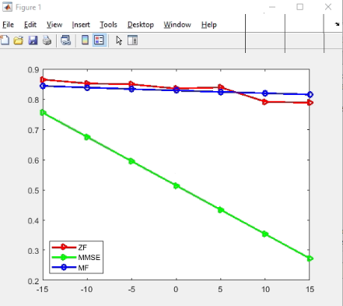
Results

Slide 16
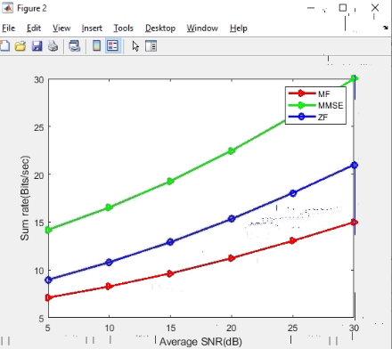

Slide 17
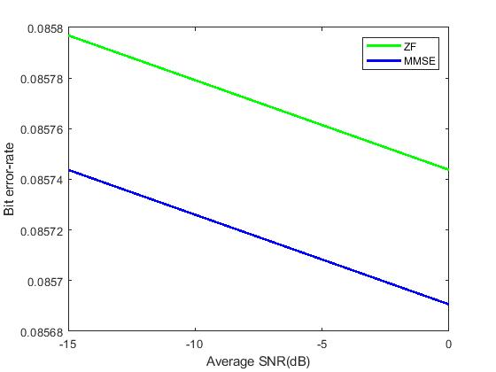

Slide 18
Conclusion:
In this paper, the main performance indexes of MRT, ZF and MMSE Linear Precoding schemes are analyzed under the model of single cell MIMO. At the same time, the rate and bit error rate of MRT, ZF and MMSE precoding are compared by simulation, and MMSE is obtained The precoding technology is obviously better than the other two precoding technologies, especially in the environment of low SNR, which verifies the conclusion of theoretical derivation.

Slide 19
References:
[1] Rusek F, Persson D, Lau B K, et al. Scaling up MIMO: Opportunities and challenges with very large arrays[J]. Signal Processing Magazine, IEEE, 2013, 30(1): 40-60.
[2] Zarei S, Gerstacker W, Schober R. A low-complexity linear precoding and power allocation scheme for downlink massive MIMO systems[C]//Signals, Systems and Computers, 2013 Asilomar Conference on.IEEE, 2013: 285-290.
[3] Ngo H Q, Larsson E G, Marzetta T L. Energy and spectral efficiency of very large multiuser MIMO systems[J]. Communications, IEEE Transactions on, 2013, 61(4): 1436-1449.
[4] Zarei S, Gerstacker W, Muller R R, et al. Low-complexity linear precoding for downlink large-scale MIMO systems[C]//Personal Indoor and Mobile Radio Communications (PIMRC), 2013 IEEE 24th International Symposium on. IEEE, 2013: 1119-1124

